Slide 1


A Hands-on Minimal Workflow for Object Detection from Satellite Imagery
Akram Zaytar • Akramzaytar@microsoft.com
Gilles Q. Hacheme • Ghacheme@microsoft.com
Aisha Alaagib • Aalaagib@aimsammi.org
Girmaw A. Tadesse • Gtadesse@microsoft.com
Thu 29 Feb 24’

Slide 2
Outline
Motivation: Geospatial ML in Africa.
Intro: Geospatial data types.
Pick a region & period of interest!
Load & visualize satellite imagery interactively.
Create a Few labels for the object of interest.
Train: image/mask generation, augmentation, local evaluation!
Inference: Run the Model over the region of interest, vectorize & postprocess the objects!
Expand it! Extensive augmentation, data fusion, multi-class, other encoders/architectures.

Slide 3
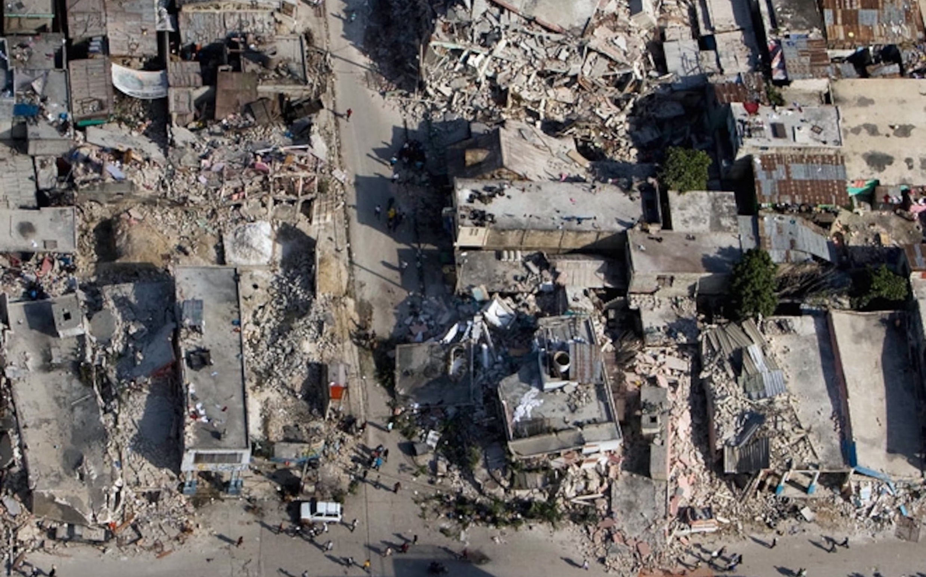
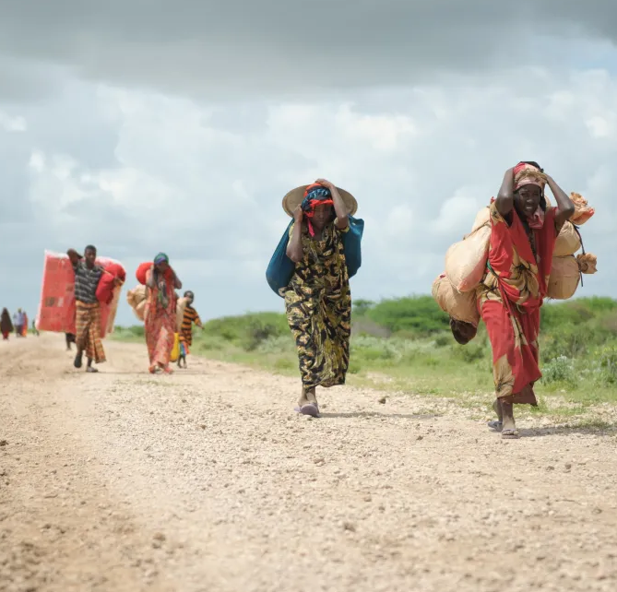
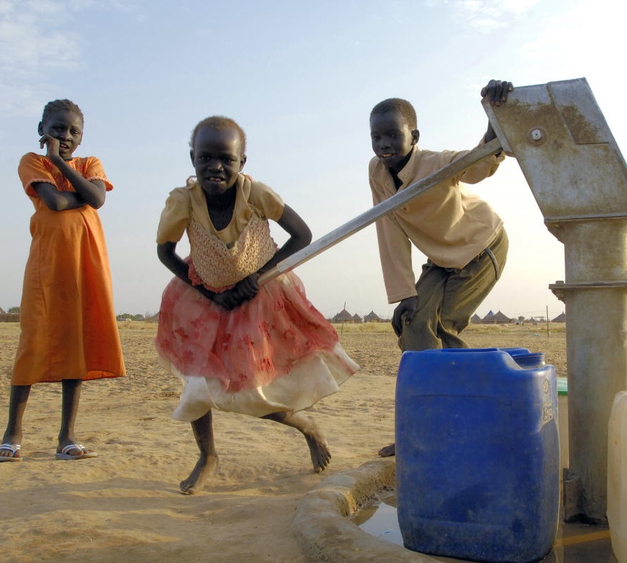
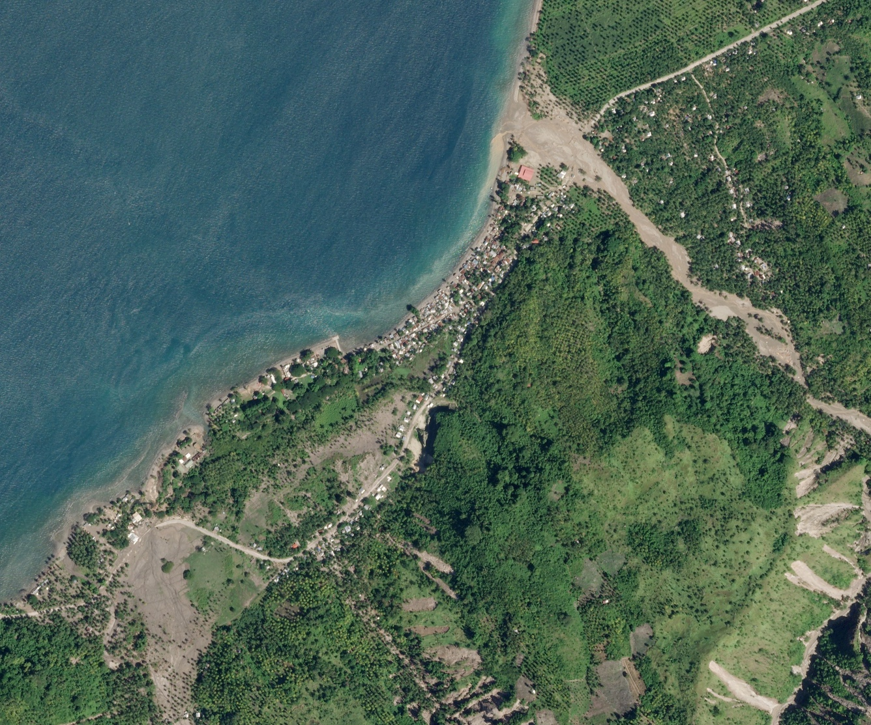
Motivation: Geospatial ML for Africa
Disaster Preparedness & Response
Population and Migration
Food and Water Security
Sustainable Development

Slide 4
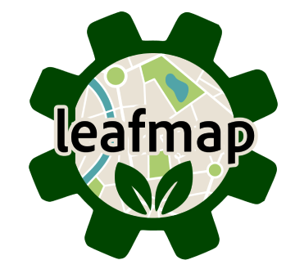





Goals
What do we want to Solve?
Mapping no-label satellite imagery require lots of effort.
Steps: image acquisition, preparation/pre-processing, setting up a labeling budget/env., sourcing compute, etc.
The above makes it difficult to use DL in regions where it is needed most, esp. in Africa.
Why this is an interesting problem?
We want to accelerate such workflows using:
Open-source software.
Publicly available satellite imagery.
Free compute in low-resource environments.
What do we want to achieve?
Showcase an end-to-end workflow for mapping objects in satellite imagery using publicly available resources.
What follows from the workflow?
You can customize the workflow to your needs & adapt it to further facilitate your geospatial ML tasks.
Tools?

Slide 5
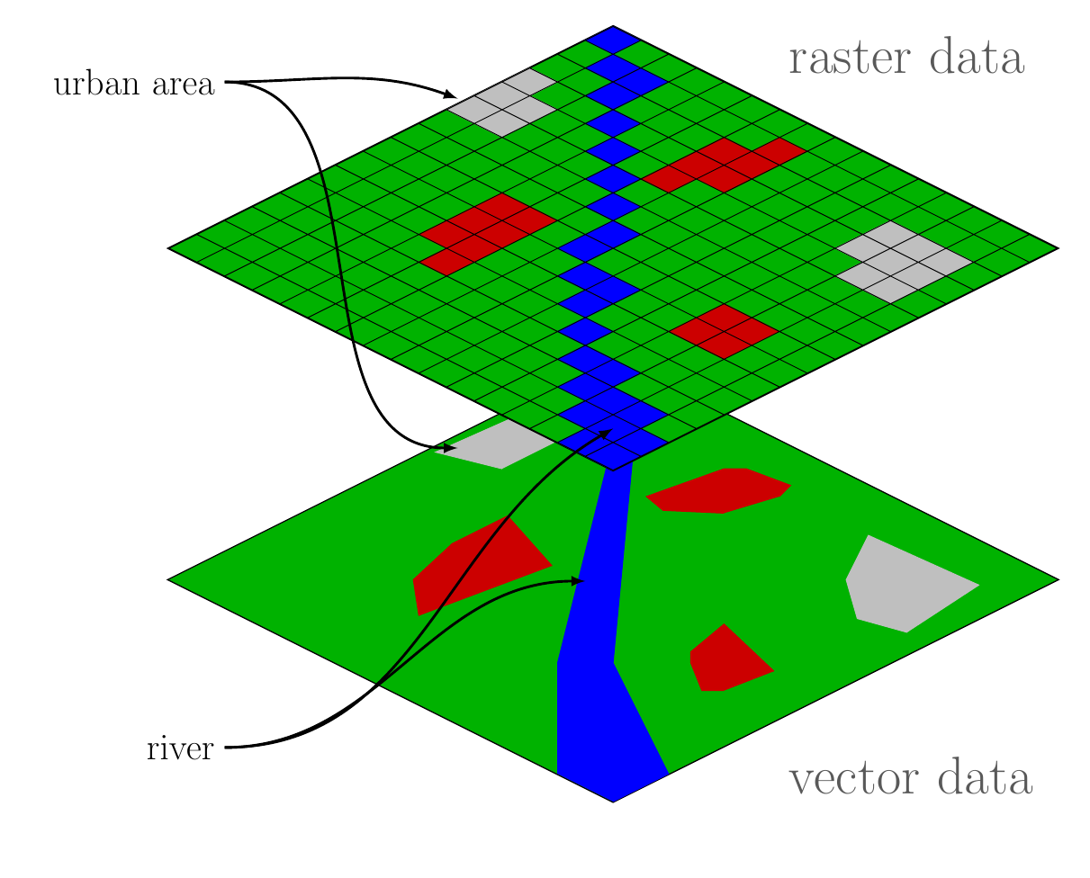
Geospatial Data
Geospatial data refers to information that can be associated with locations on Earth. Examples:
Weather information.
Transportation networks.
Population density.
There are two types of geospatial data:
Vector: points, lines, polygons, etc. Vector objects are geometries that may have multiple attributes. Such data is saved in a vector file (e.g., `Shapefile` (.shp), `GeoJSON`, among others).
Raster: represented as a grid of pixels, each pixel holds a value that represents a measurement. Raster data is stored in format like `GeoTIFF` and `NetCDF`.
We will use both data types during the session.
Credit: Pan Geography.

Slide 6
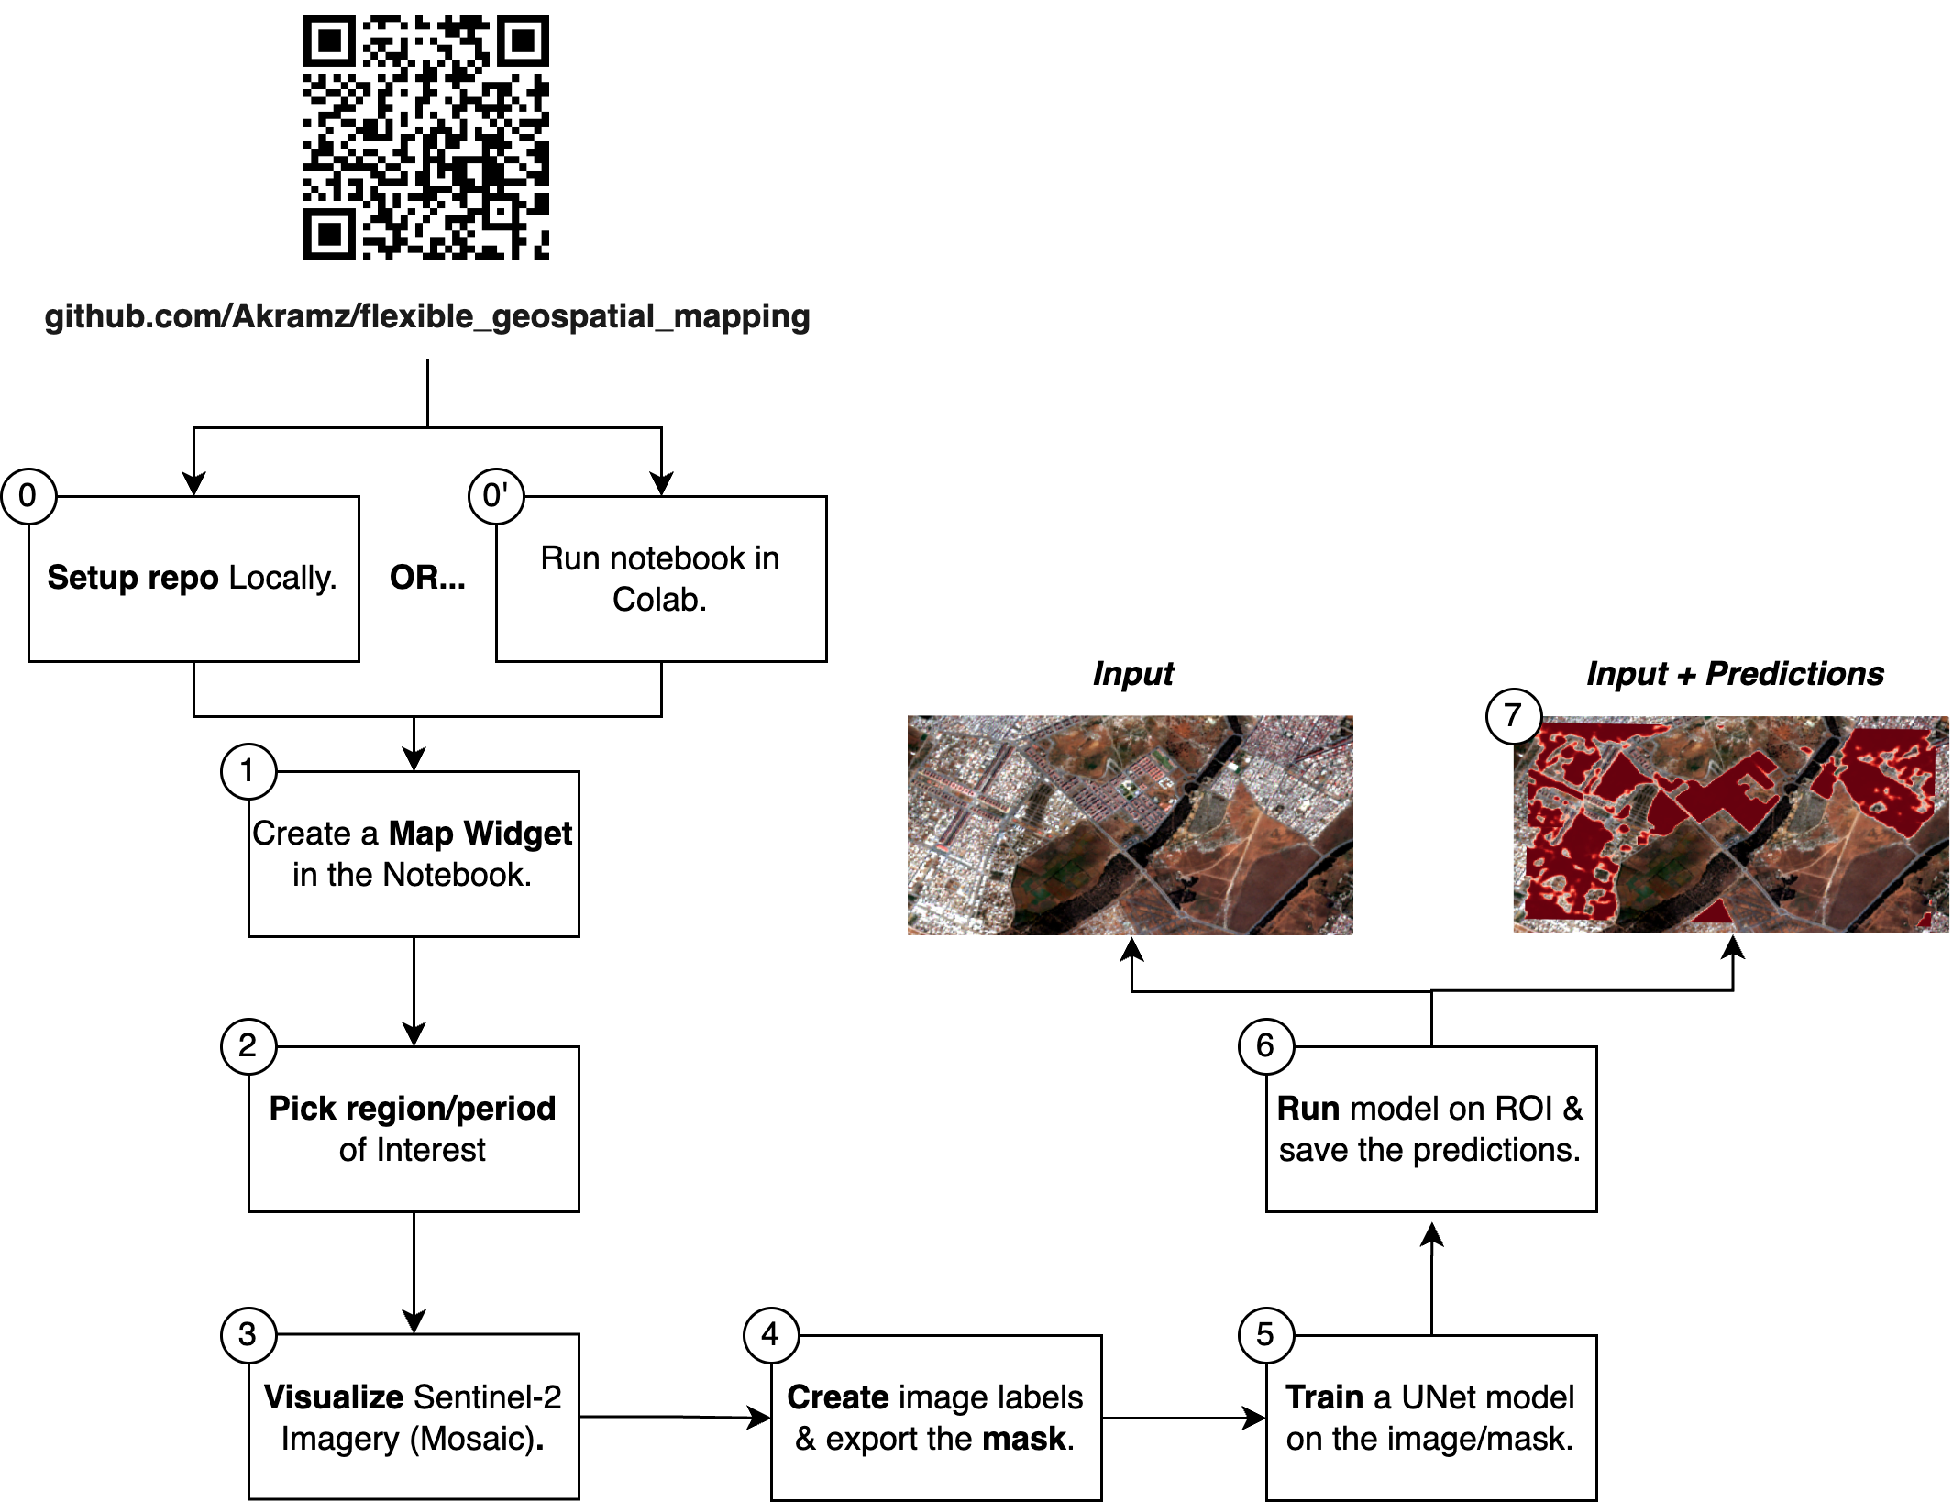
Workflow

Slide 7
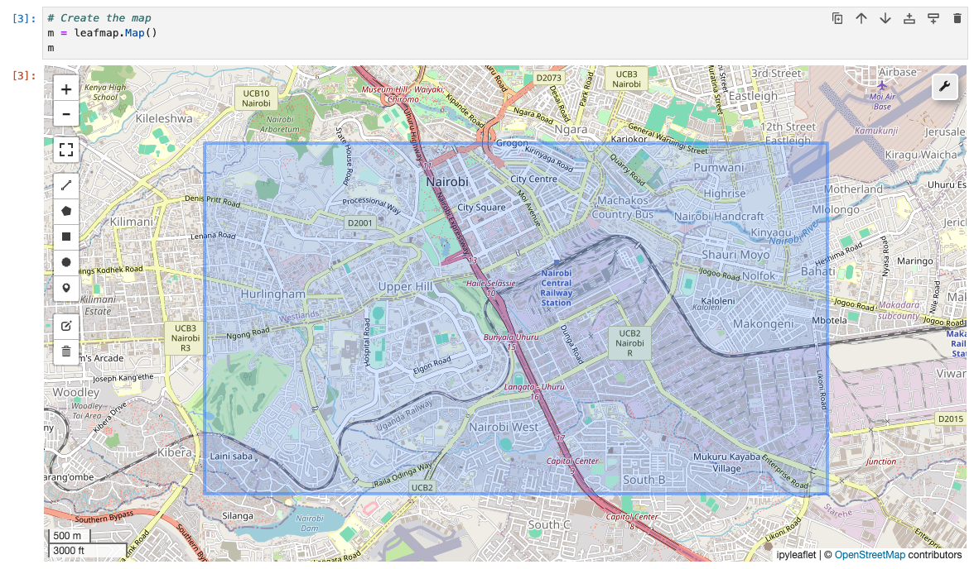
Step 1: Pick a Region/Period of Interest
We create the region of interest (ROI) by:
Setting up the Jupyter notebook env.
Initializing a leafmap object.
Manually creating the ROI.
We also create a period of interest (start/end dates). We use the dates to filter for the available imagery.
Leafmap’s mapping & labeling widget.

Slide 8
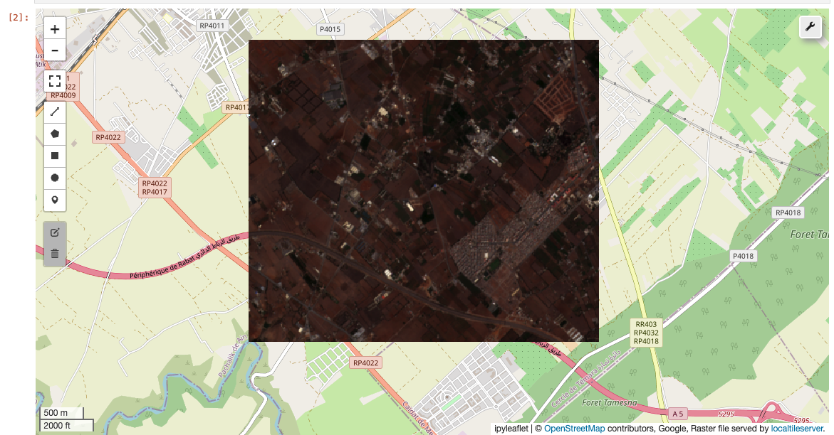
Step 2: Acquire, Load, & Visualize the Imagery
Once we have the ROI + Dates, we can:
Create a Mosaic from the spatio-temporal filter.
Acquire the Imagery & Load it into the map.
Interactively visualize the imagery.
Interactive mapping is important because we can quickly make sure that:
The image corresponds to the ROI.
Difference between the basemap & image is as expected.
We can label such image & expect learning to succeed.
The acquired mosaic image visualized on Leafmap.

Slide 9
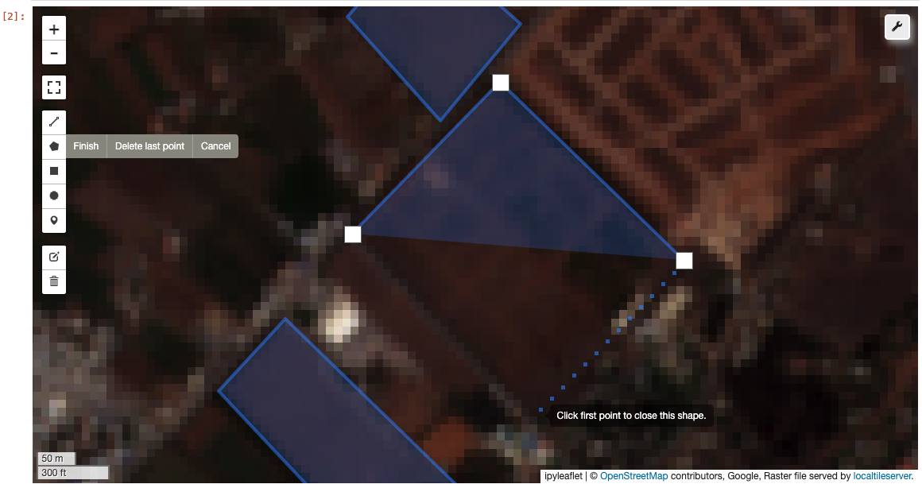
Step 3: Create a Few Object Labels
We can use the labeling tools to create multiple Polygons for the object of interest. Some rules:
There is no need to label the whole ROI.
The more labels, the better (but not so much!).
All other pixels within the extents of the polygons will be considered `negative`.
The Image/Mask will be spatially split:
The polygons will be used to create train/validation masks
You can choose to split it horizontally or vertically.
Validation metrics can be pixel or object wise.
We can use leafmap tools to create a few object labels.

Slide 10
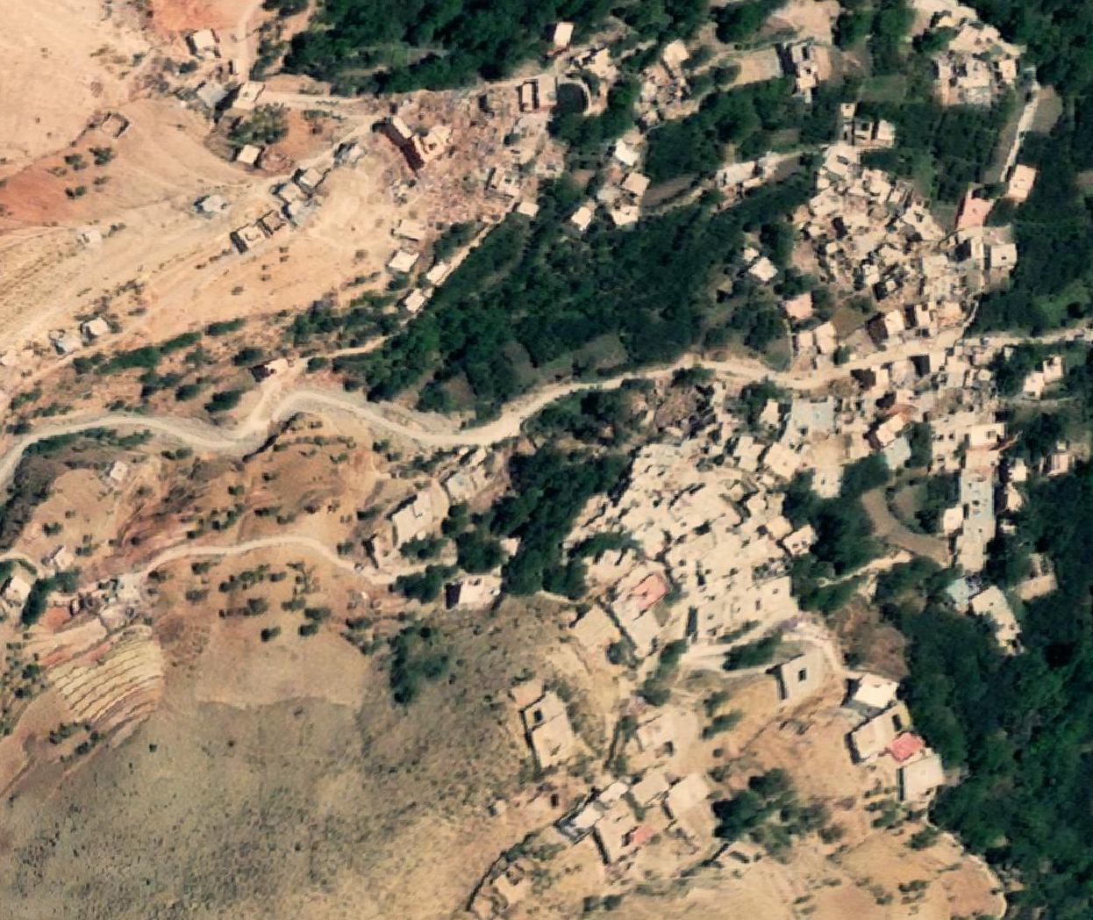
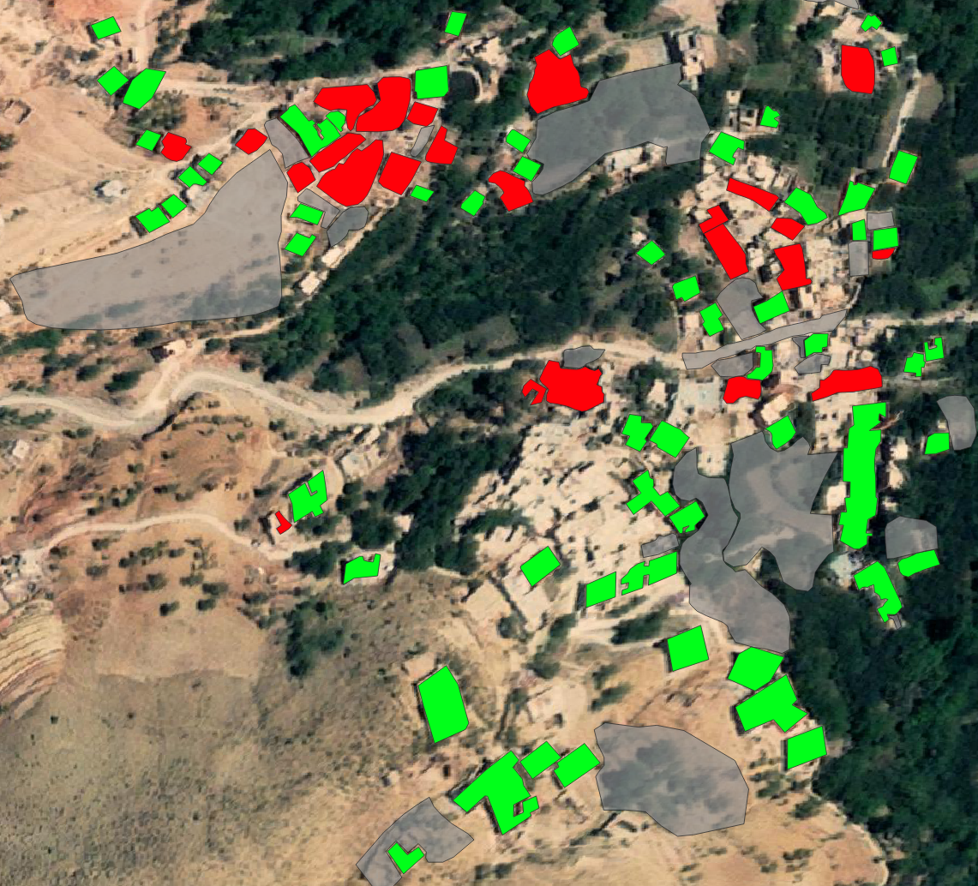
Tip: Pick a difficult Area to Label!
Label
Example difficult region for labeling (Morocco).
Building in Green.
Destroyed buildings in Red.

Slide 11

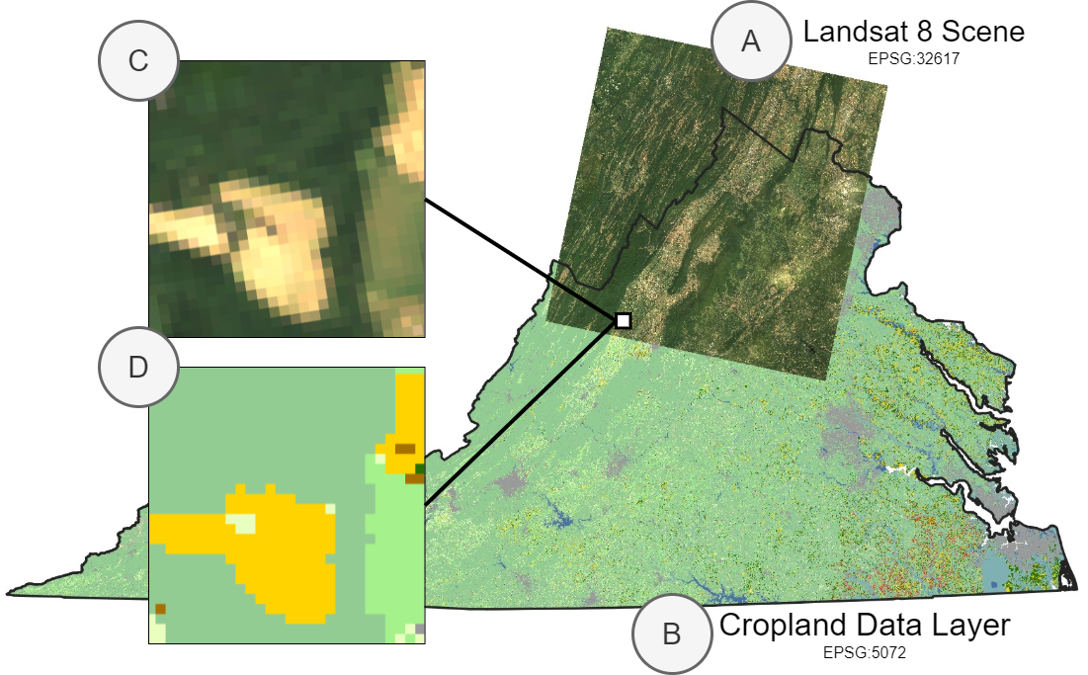
Step 4: Train & Evaluate!
As we have limited labels, we need to do:
Data augmentation: horizonal/vertical Flipping, Rotation, Color jitter, Crop and Resize, Blurred, etc.
Random patch sampling from the image.
Regularization: entropy & consistency.
When evaluating, we can report the following on the validation ROI:
Pixel Recall/Precision/F1 score, Jaccard (IoU).
Object-level metrics after postprocessing the predicted masks into polygons.
— TorchGeo for Patch Sampling—
A) a scene from Landsat 8 and B) Cropland Data Layer labels, even though these files are in different EPSG projections. We want to sample patches C) and D) from these datasets using a geospatial bounding box as an index.

Slide 12
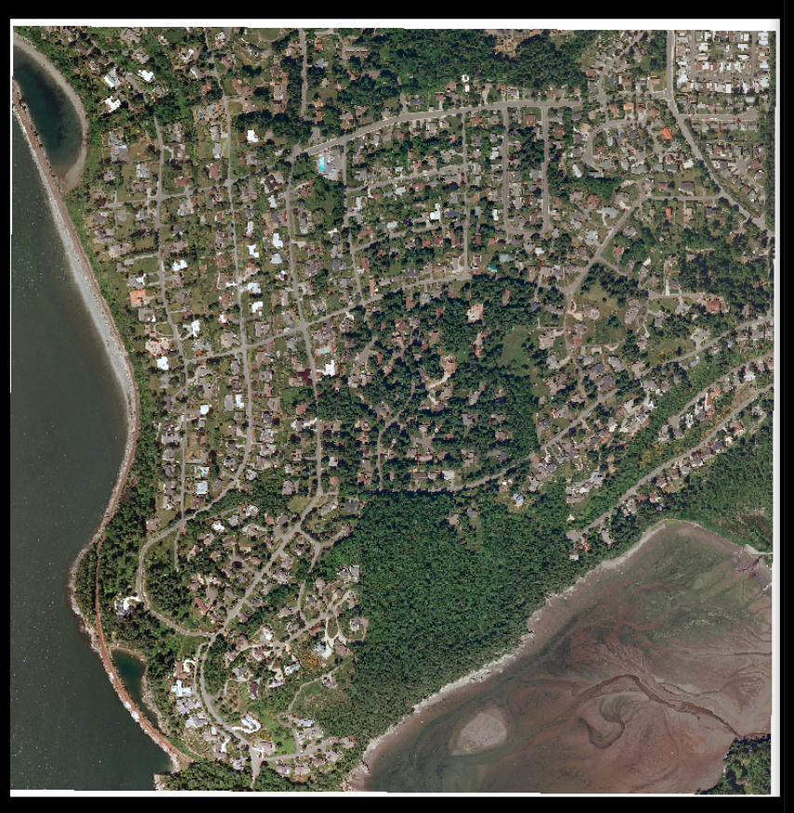
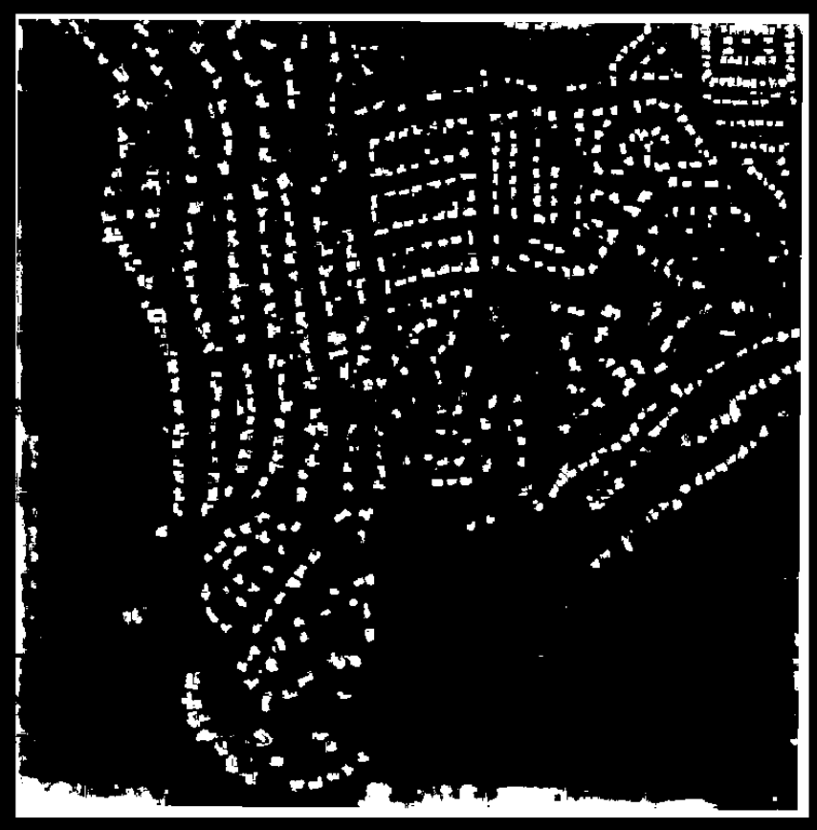
Step 5: Inference
After obtaining satisfactory results, we can:
Run the model over the original ROI: we can accelerate prediction by gridding the image & loading it in batches.
Vectorize the target object class.
Postprocess: any cleaning steps that are based on assumptions about the nature of the object (area, #edges, shape, etc)
Once we achieve local generalization, we can…
Try the model on adjacent regions.
Test the model on other periods.
Inference

Slide 13
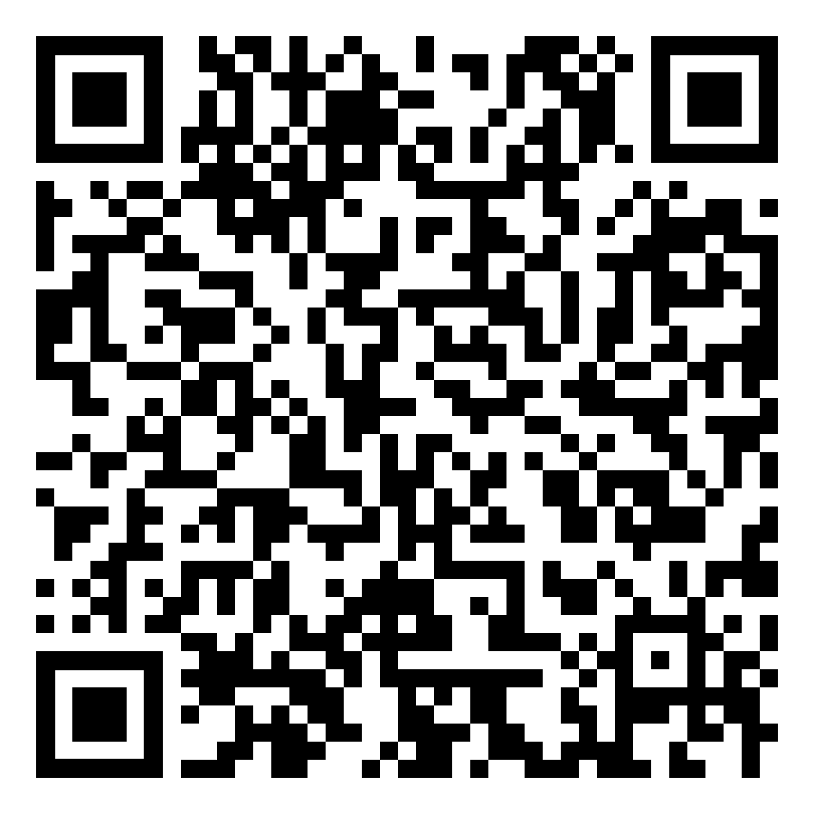

Step 6: Expand the Workflow!
Once you have completed all the steps successfully, you can…
Try other architectures & encoders.
Use other data augmentation techniques.
Implement semi-supervised learning techniques.
Fuse data from different layers (e.g., Sentinel-1 and 2).
Scale the problem to multi-class categorization.
Additional resources can be found at the end of the notebook.
Join the GeoAI Africa Community to contribute to Geospatial Research and Applications in Africa

